Slide 1
Breast Cancer Capstone Project
Springboard Data Science Career Track
Abbas Zaidi

Slide 2

Project Proposal and Problem Statement
Early detection can be the difference between life and death as breast cancer mortality falls 75% when detected in stage 1 versus stage 4
Lab results provide a significantly cheaper method of potential cancer diagnosis as they cost hundreds or thousands of times less than radiology
Cost is the number one reason women do not have regular cancer screenings for 53% of women in a survey

Slide 3
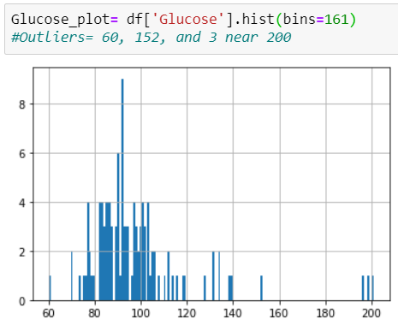
Data Wrangling
Data was indexed in order to make it easier to read
Histograms such as the one on the right for glucose were created to determine outliers
Means of lab values were calculated and compared between control and cancer patients to determine which types of lab results to use
Glucose, Insulin, Resistin, MCP.1, and HOMA were selected as the most promising lab values based on means

Slide 4
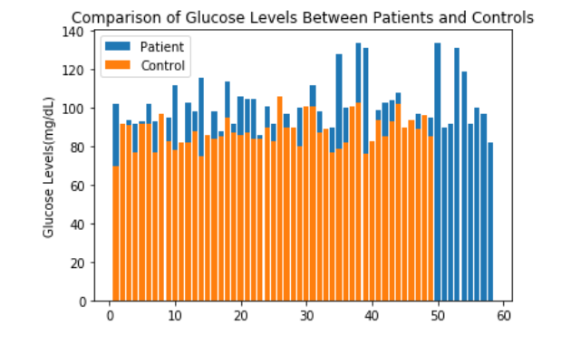
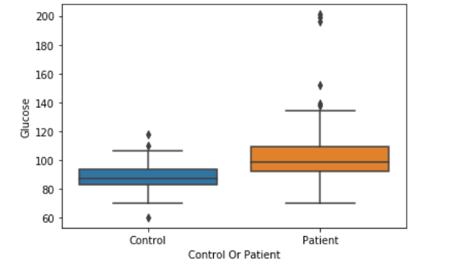
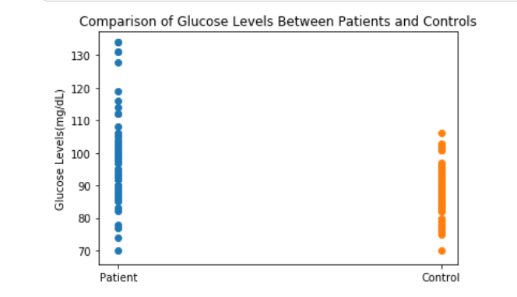
Data Storytelling
Data was visualized using box plots, dot plots, and histograms
Examples shown are for glucose values

Slide 5
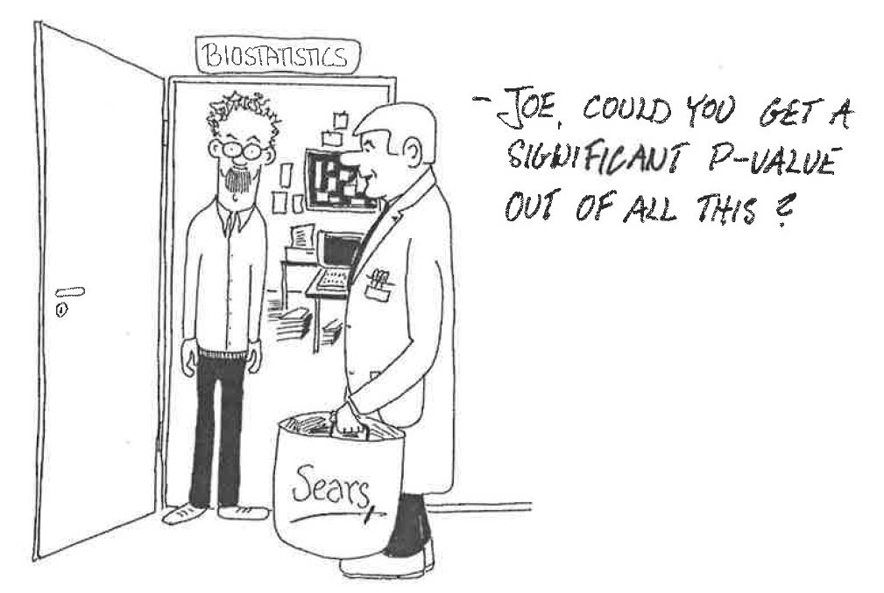
Statistical Analysis
Pearson Correlation and P-values were calculated for glucose, insulin, resistin, MCP.1, and HOMA blood values for both control and cancer values
Resistin, HOMA, insulin, and glucose were all significantly greater for cancer patients compared to control patients based on both Pearson correlation and significant p-values
MCP.1 was not found to be significantly different for the groups for either test

Slide 6
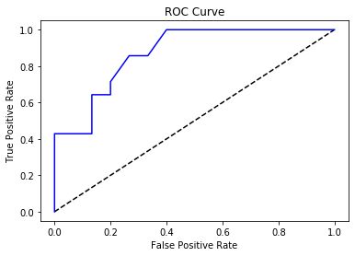
Machine Learning Analysis
Classification supervised machine learning was run to try to create a model to predict whether lab values were for controls or patients
The model proved to have a 0.75 auc-roc score which is considered fairly accurate
This is a promising start, however, the medical community strives for a 0.95 auc-roc score in order to be applicable
Additional research and tuning of the model is necessary for more meaningful results and methods to be found

Slide 7
Works Cited
Rosenberg, Abe. “Cancer and Diabetes: More Connections Than You Think.” City of Hope Comprehensive Cancer Center, City of Hope, 21 June 2019, www.cityofhope.org/cancer-and-diabetes-more-connections-than-you-think/.
“Breast Cancer Symptoms and Early Warning Signs.” WebMD, WebMD, www.webmd.com/breast-cancer/understanding-breast-cancer-symptoms.
McAlearney, Ann Scheck, et al. “Cost as a Barrier to Screening Mammography among Underserved Women.” Ethnicity & Health, U.S. National Library of Medicine, Apr. 2007, www.ncbi.nlm.nih.gov/pmc/articles/PMC4465254/.
Nbcf. “Information, Awareness & Donations :: The National Breast Cancer Foundation.” Www.nationalbreastcancer.org, www.nationalbreastcancer.org/.
“U.S. Breast Cancer Statistics.” Breastcancer.org, 13 Feb. 2019, www.breastcancer.org/symptoms/understand_bc/statistics.
“Why Is Early Diagnosis Important?” Cancer Research UK, 4 Mar. 2019, www.cancerresearchuk.org/about-cancer/cancer-symptoms/why-is-early-diagnosis-important.
https://www.touchstonehs.org/wp-content/uploads/2017/10/breast-cancer-blog-post-image-2017.jpg
https://getitglossary.org/uploads/Pic_36.JPG

